Slide 1

GarIt !
Integrated Crop Management
小喵小肥的農村日常
Tom and Jerry’s Country Diary

Slide 2
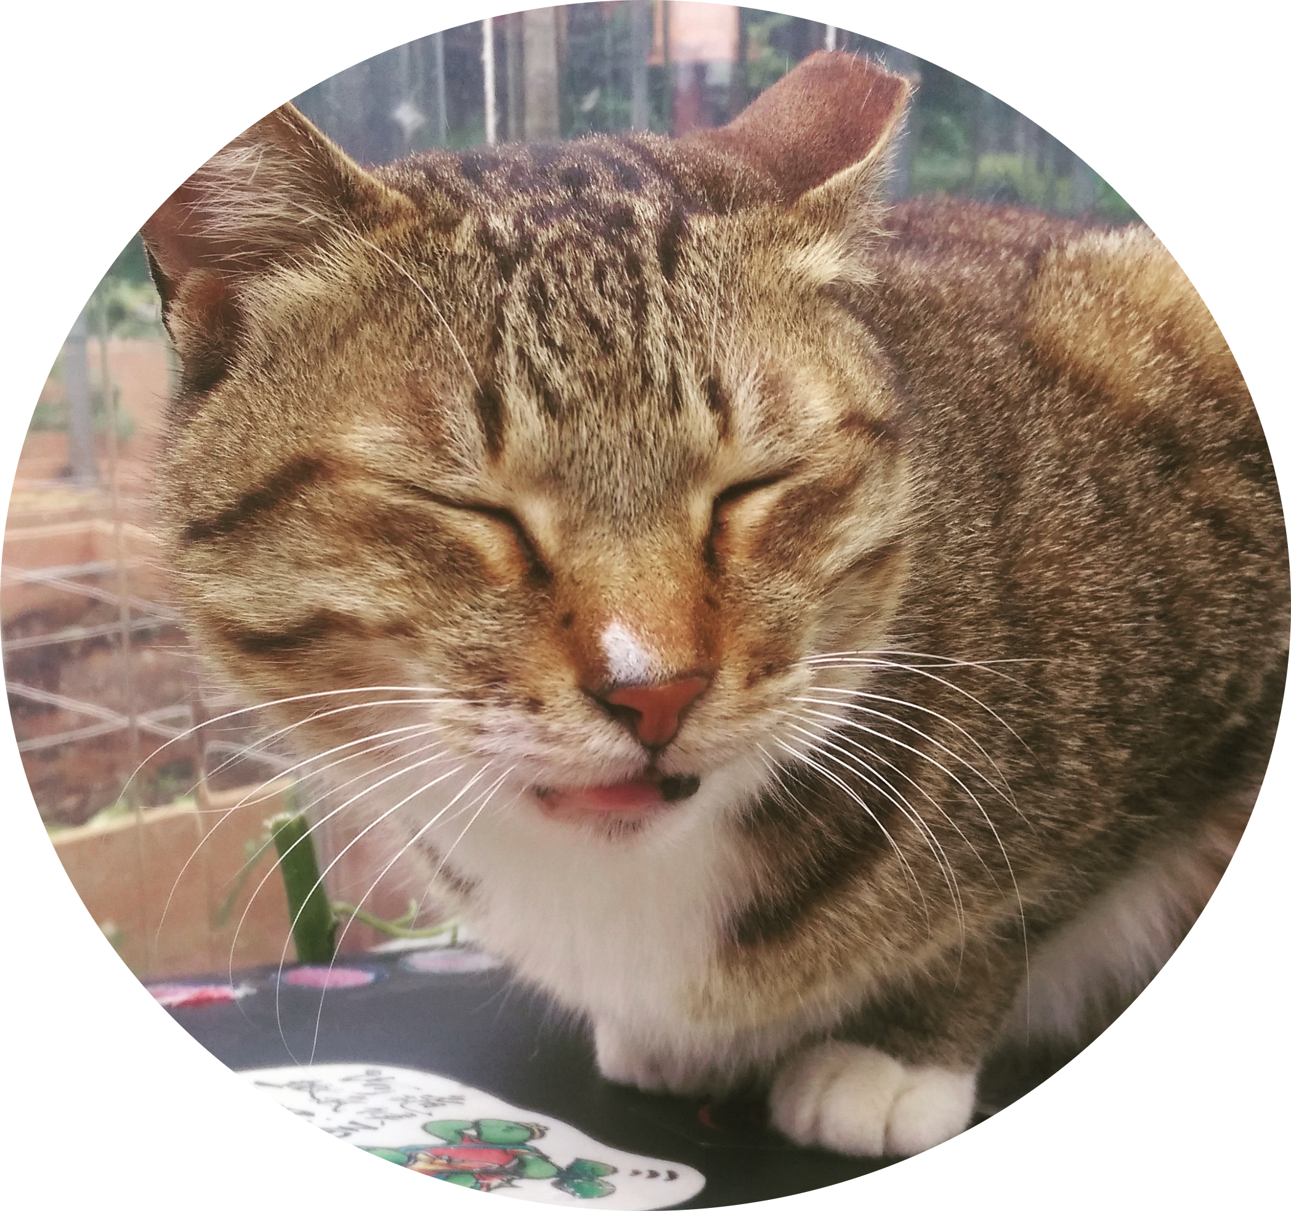




Team
Manager
小喵
★ Farmer
yan
Bioinformatician
Kuan-Yi
DeveloperEddie
Designer
小T

Slide 3
Agricultural Problems We Are Facing

Slide 4
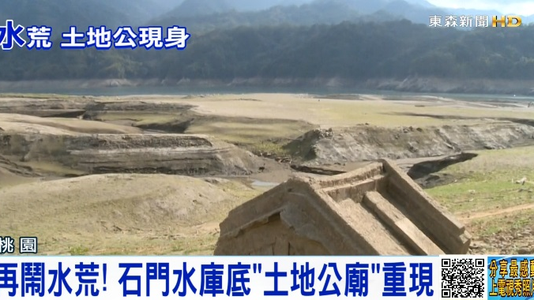
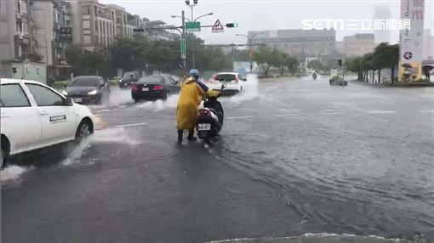
Radical Weather
2015
2018
Notes:
Present: Radical, Past: Rather stable and similar between years, now intuitions does not work well.

Slide 5
Human Resource Issues
Knowledge transfer inefficiency
Tacit knowledge (Learning ONLY by doing)
Experience do not apply
Manpower shortage
Declined agricultural population
Notes:
Because of radical weather (rapid changing environment), experience often do not apply, making situations even harder.

Slide 6
GarIt !
Open Beta to Agricultural Community
50+ Early Birds
20+ Weekly Active Users
Notes:
To solve these problems, we need a systematic and scientific way of crop management.

Slide 7
How We Do It
Growing Tips
Traceability Report
GarIt !
Weather Information
Automation (Irrigation)
Crop Database
Weather Alarm
Cultivation Record
Pest and Disease Database
Pest and Disease Alert
Notes:
Knowledge, manpower shortage

Slide 8
Demo

Slide 9
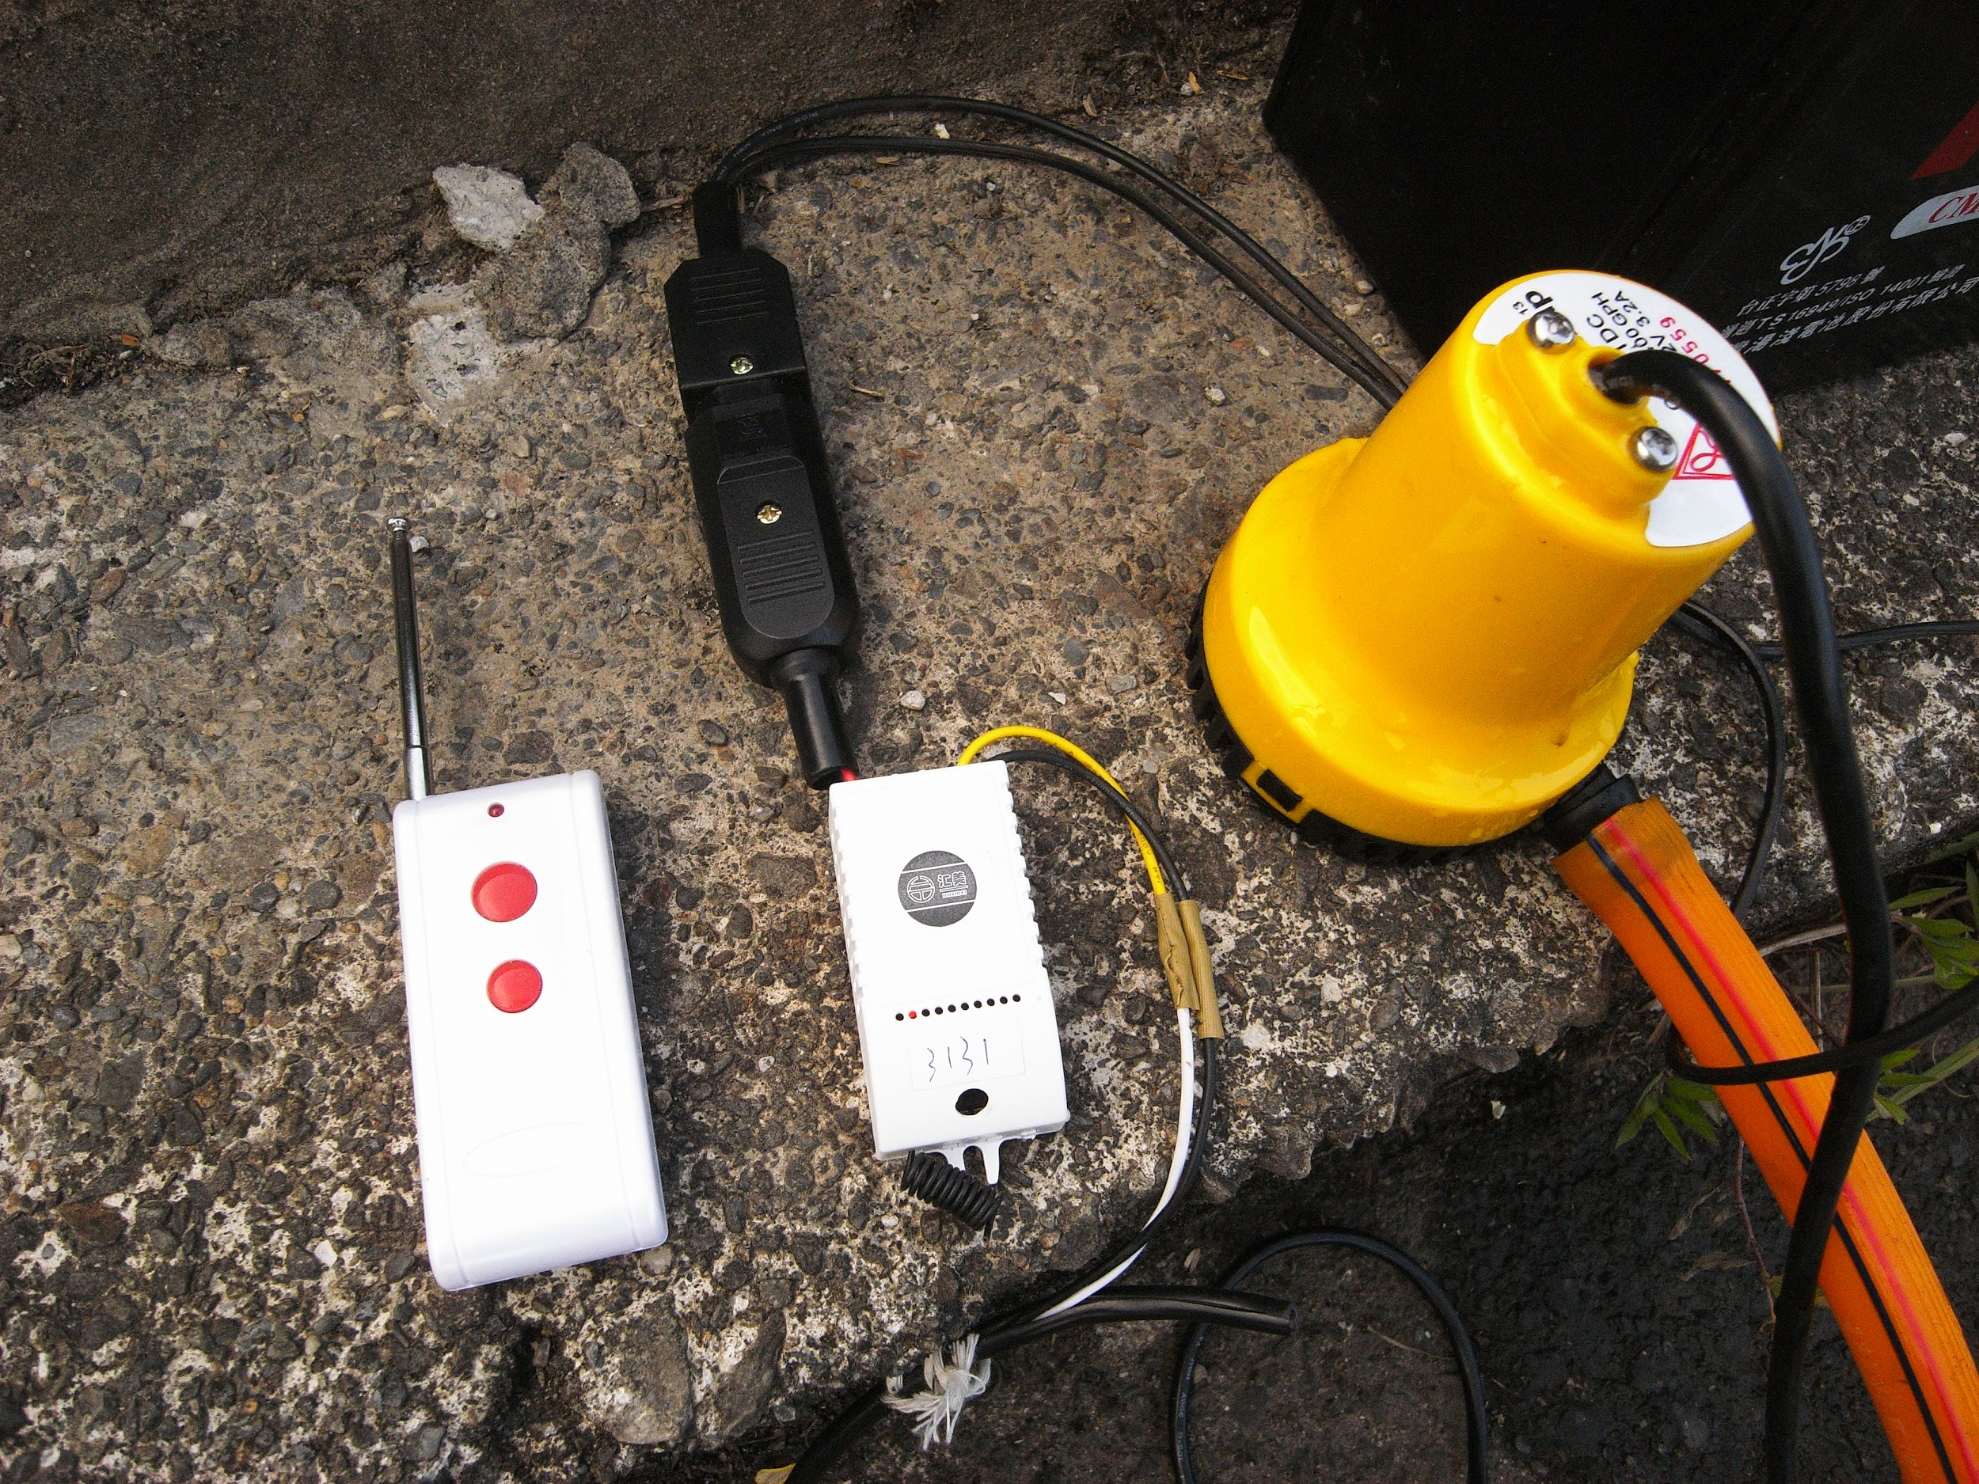
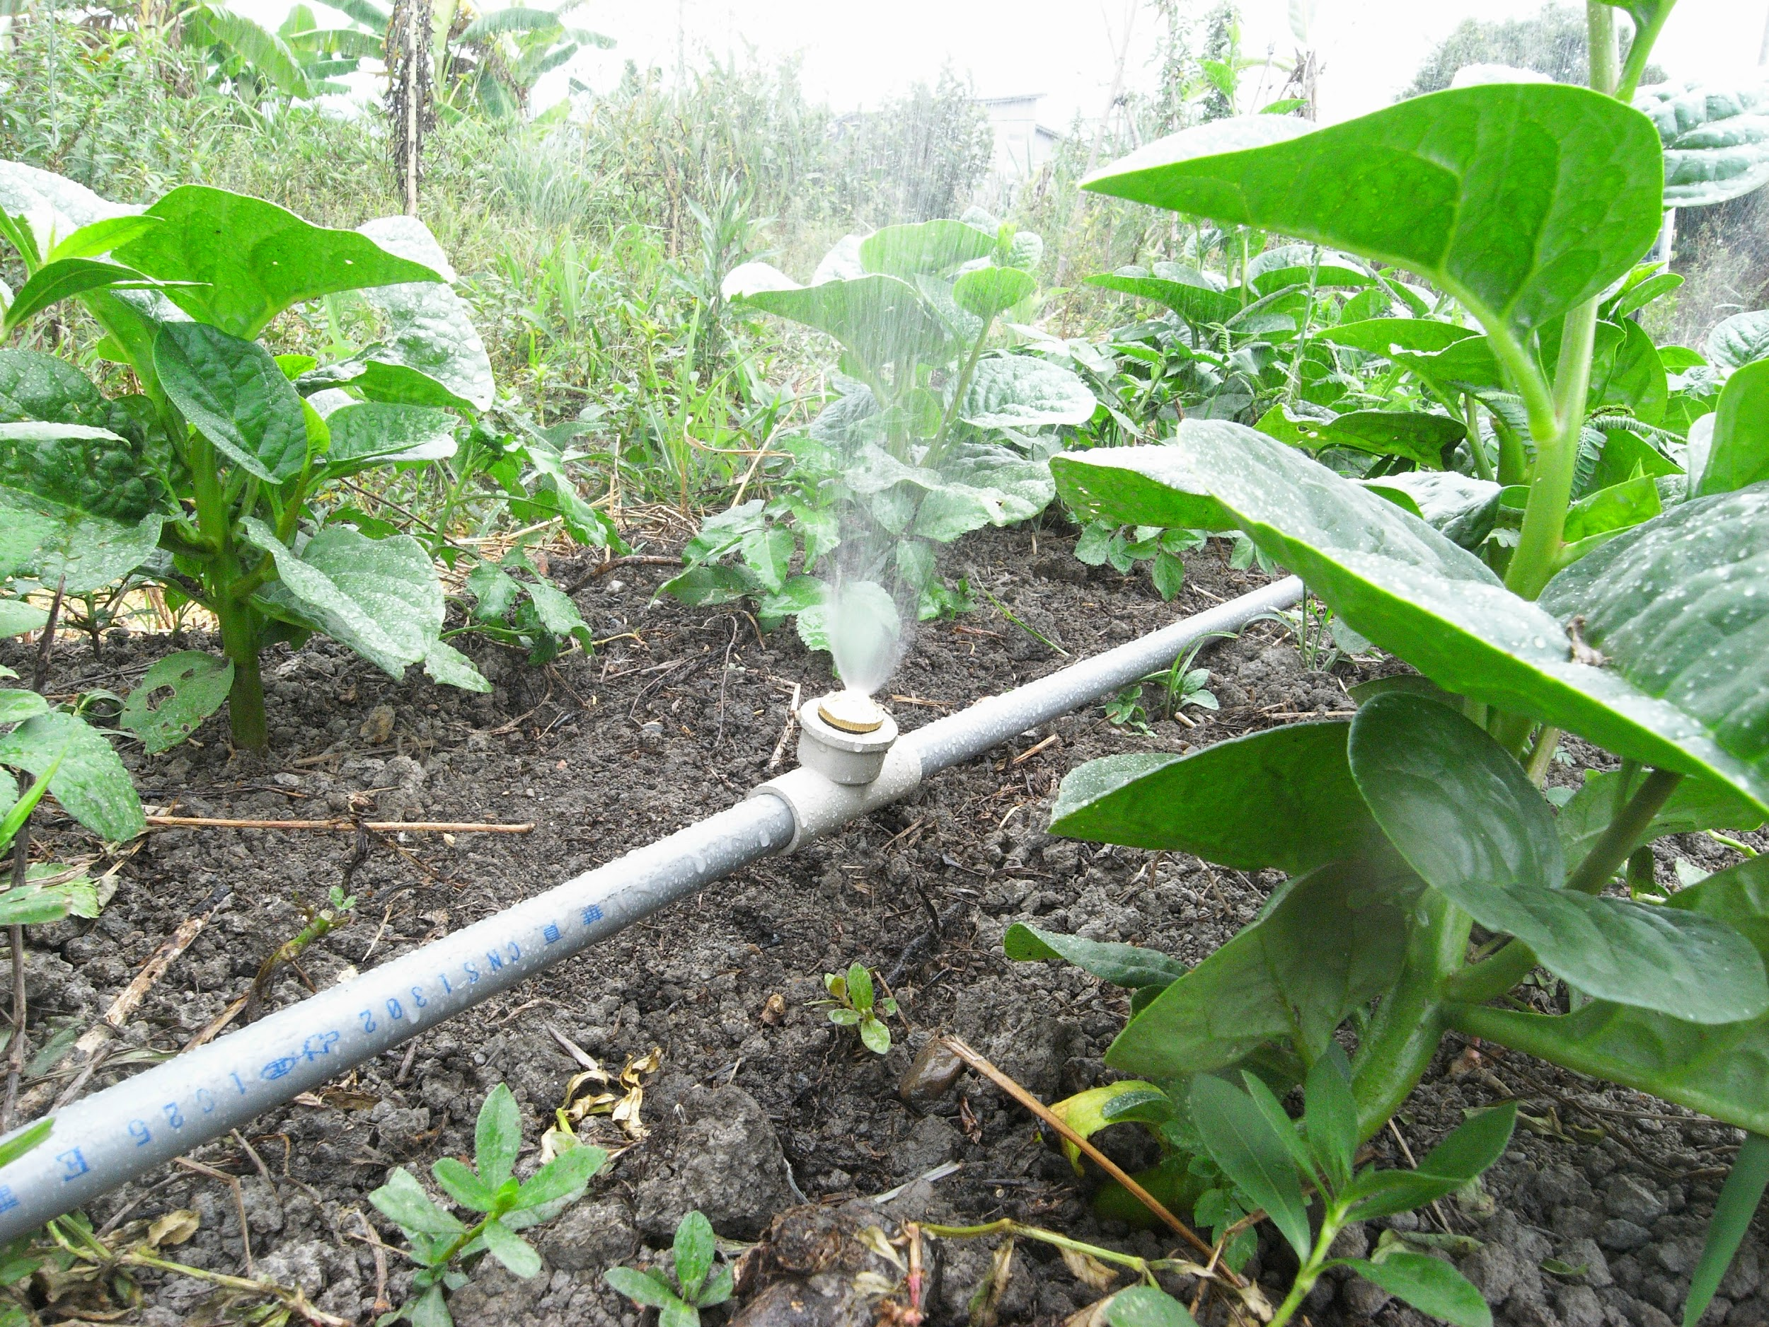
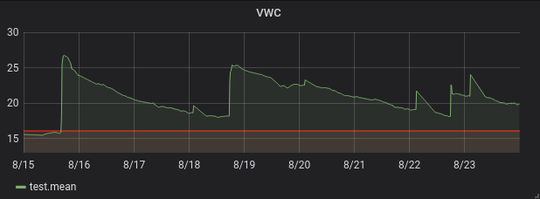
Smart machinery connection

Slide 10
Open Data & API
中央氣象局 - 自動氣象站-氣象觀測資料
中央氣象局 - 天氣特報-各別天氣警特報之內容及所影響之區域
行政院農業委員會 - 產銷履歷
行政院農業委員會 - 重要農業害蟲診斷圖鑑
Open Hack Farm - Crops Suggestion

Slide 11
Source Code
GarIt ! LineBot
https://github.com/OpenHackFarm/GarIt-LineBot
OHF API
https://github.com/OpenHackFarm/ohf-api-proxy
WeatherProxy
https://github.com/OpenHackFarm/WeatherProxy

Slide 12
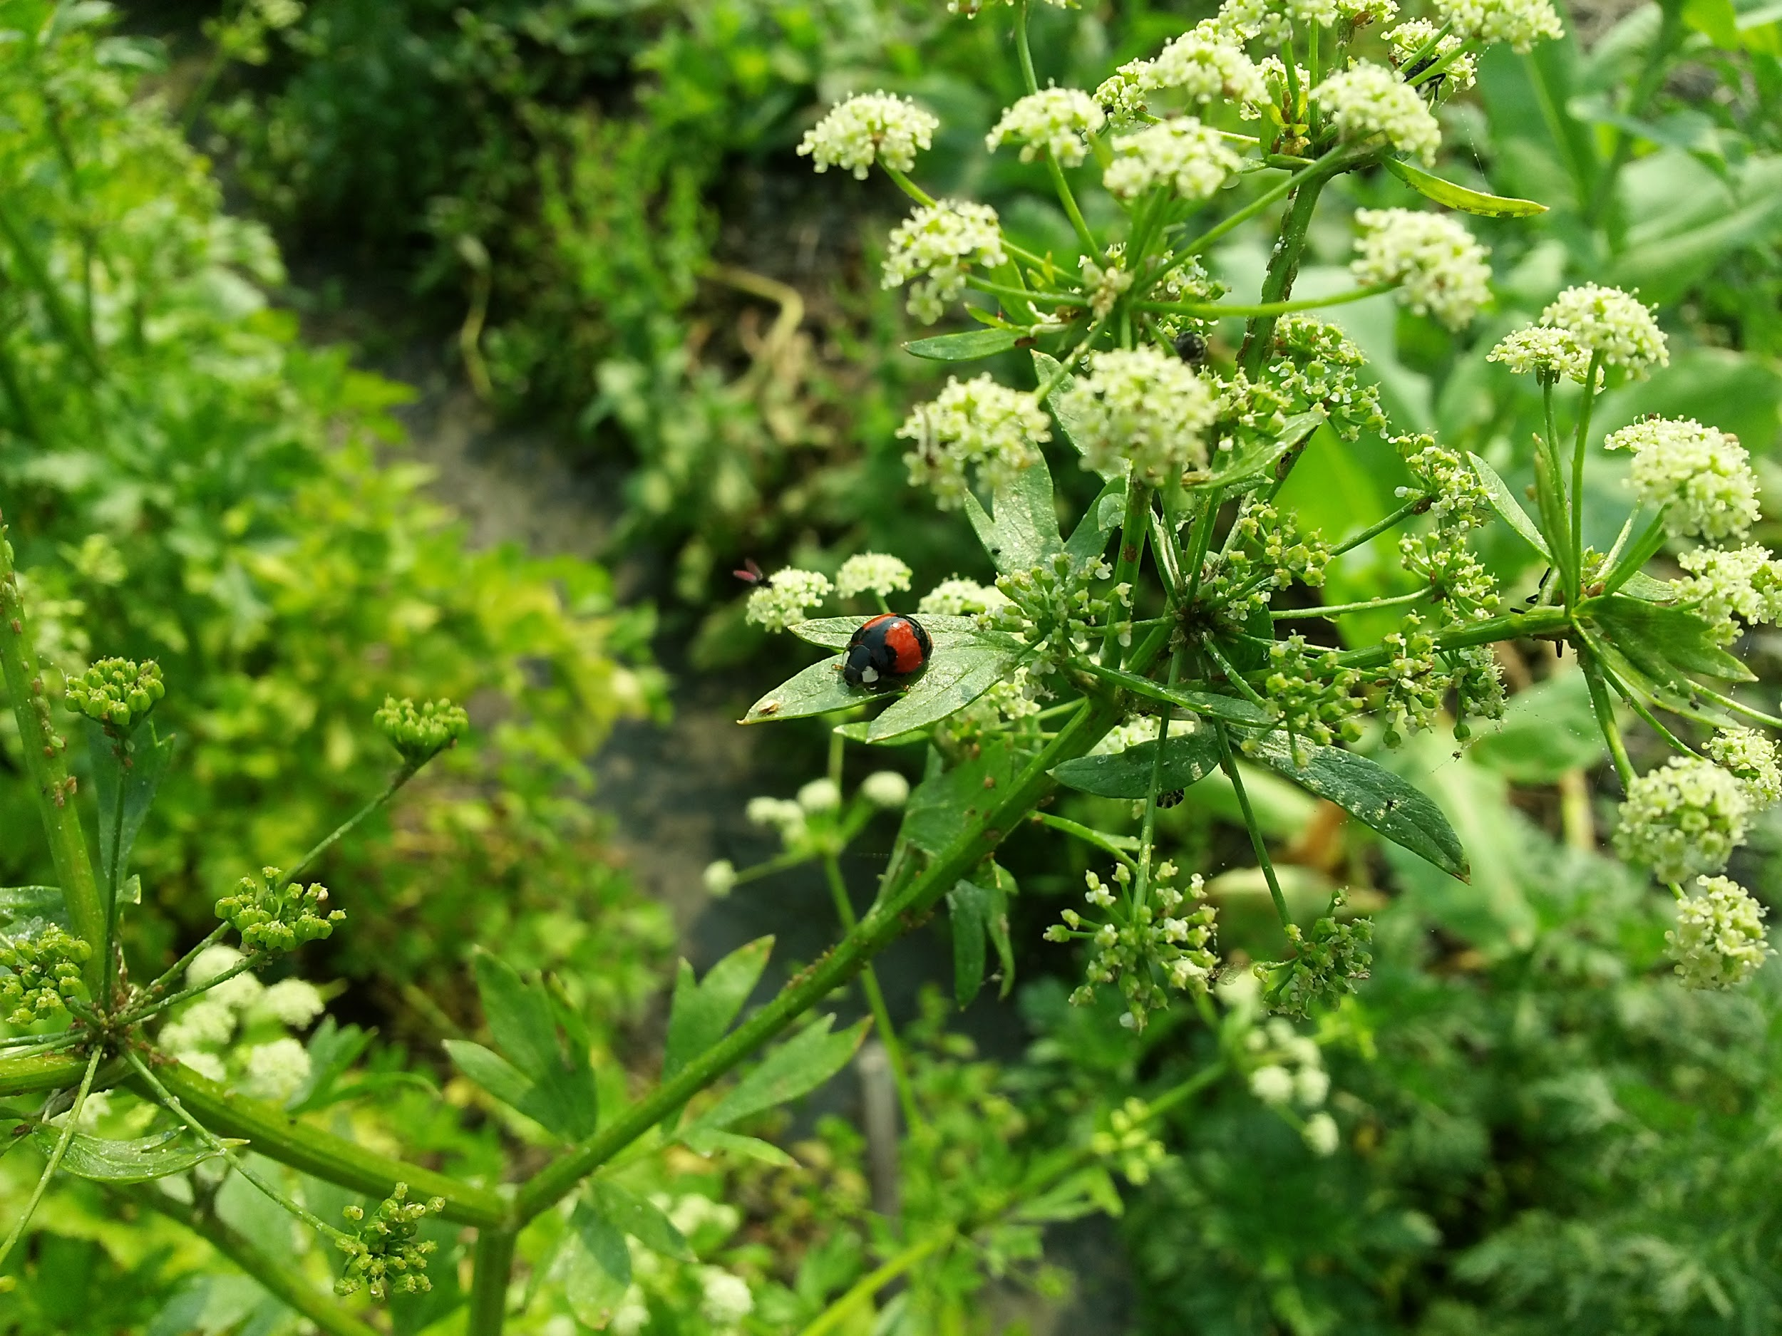
Who want the fresh foods ?

